Slide 1
Red Light Traffic Cameras
Evaluating if Chicago’s Red Light Cameras Reduce Total Crashes and Injuries at Intersections

Slide 2
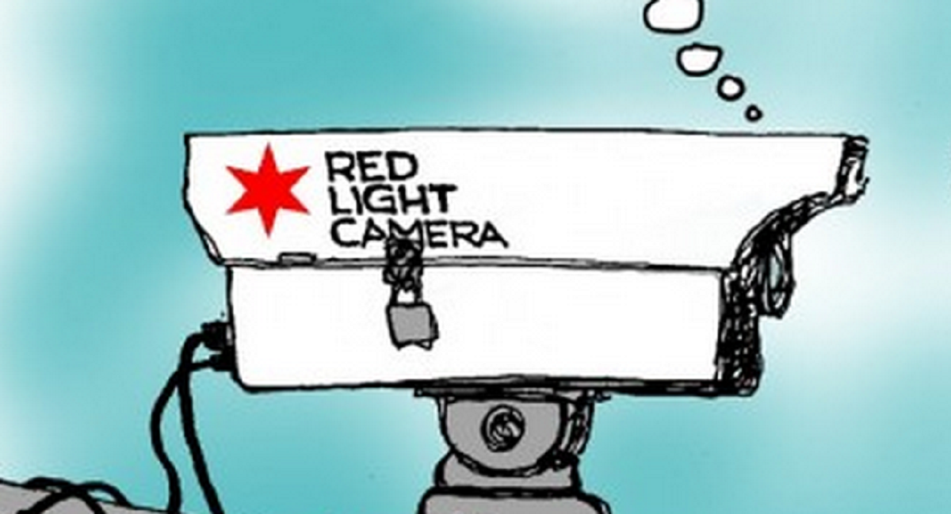
Background
City of Chicago began the Red Light Camera Program in 2003
The City has justified the program by stating it reduces crashes and injuries
The City cites two studies: IDOT 2005-2012 and Northwestern's 2017 report --Chicago Red Light Camera Enforcement: Best Practices & Program Road Map
Notes:
Problems, the government cited itself.

Slide 3
Literature Review
Different studies identify reductions in total crashes at intersections by 30% (IDOT, 2012, European Studies, and Northwestern 2017)
Other studies claim yellow light time, and traffic lanes are contributing factors (Retting et al. 2008)
Data is typically form the National Highway Transportation Safety administration (NHTSA), IDOT, and Police Crash Reports

Slide 4
Literature Review
Previous Studies Cite Count Data Models for Descriptive and Inferential Statistical Analysis
Poisson, Negative Binominal,
Geospatial Determination
GPS is used to Map Crashes at Intersections
What’s Appropriate Diameter?
125 ft, 135 ft, 100 ft

Slide 5
Math Literature Review
Regression Models with Count Data Outline
Poisson Regression Negative Binomial Regression Zero-Inflated Count Models
Zero-inflated Poisson
Zero-inflated Negative Binomial
Zero-Truncated Count Models
Zero-truncated Poisson
Zero-truncated Negative Binomial
Hurdle Models
Random-effects Count Models
Notes:
http://stats.idre.ucla.edu/stata/seminars/regression-models-with-count-data/

Slide 6
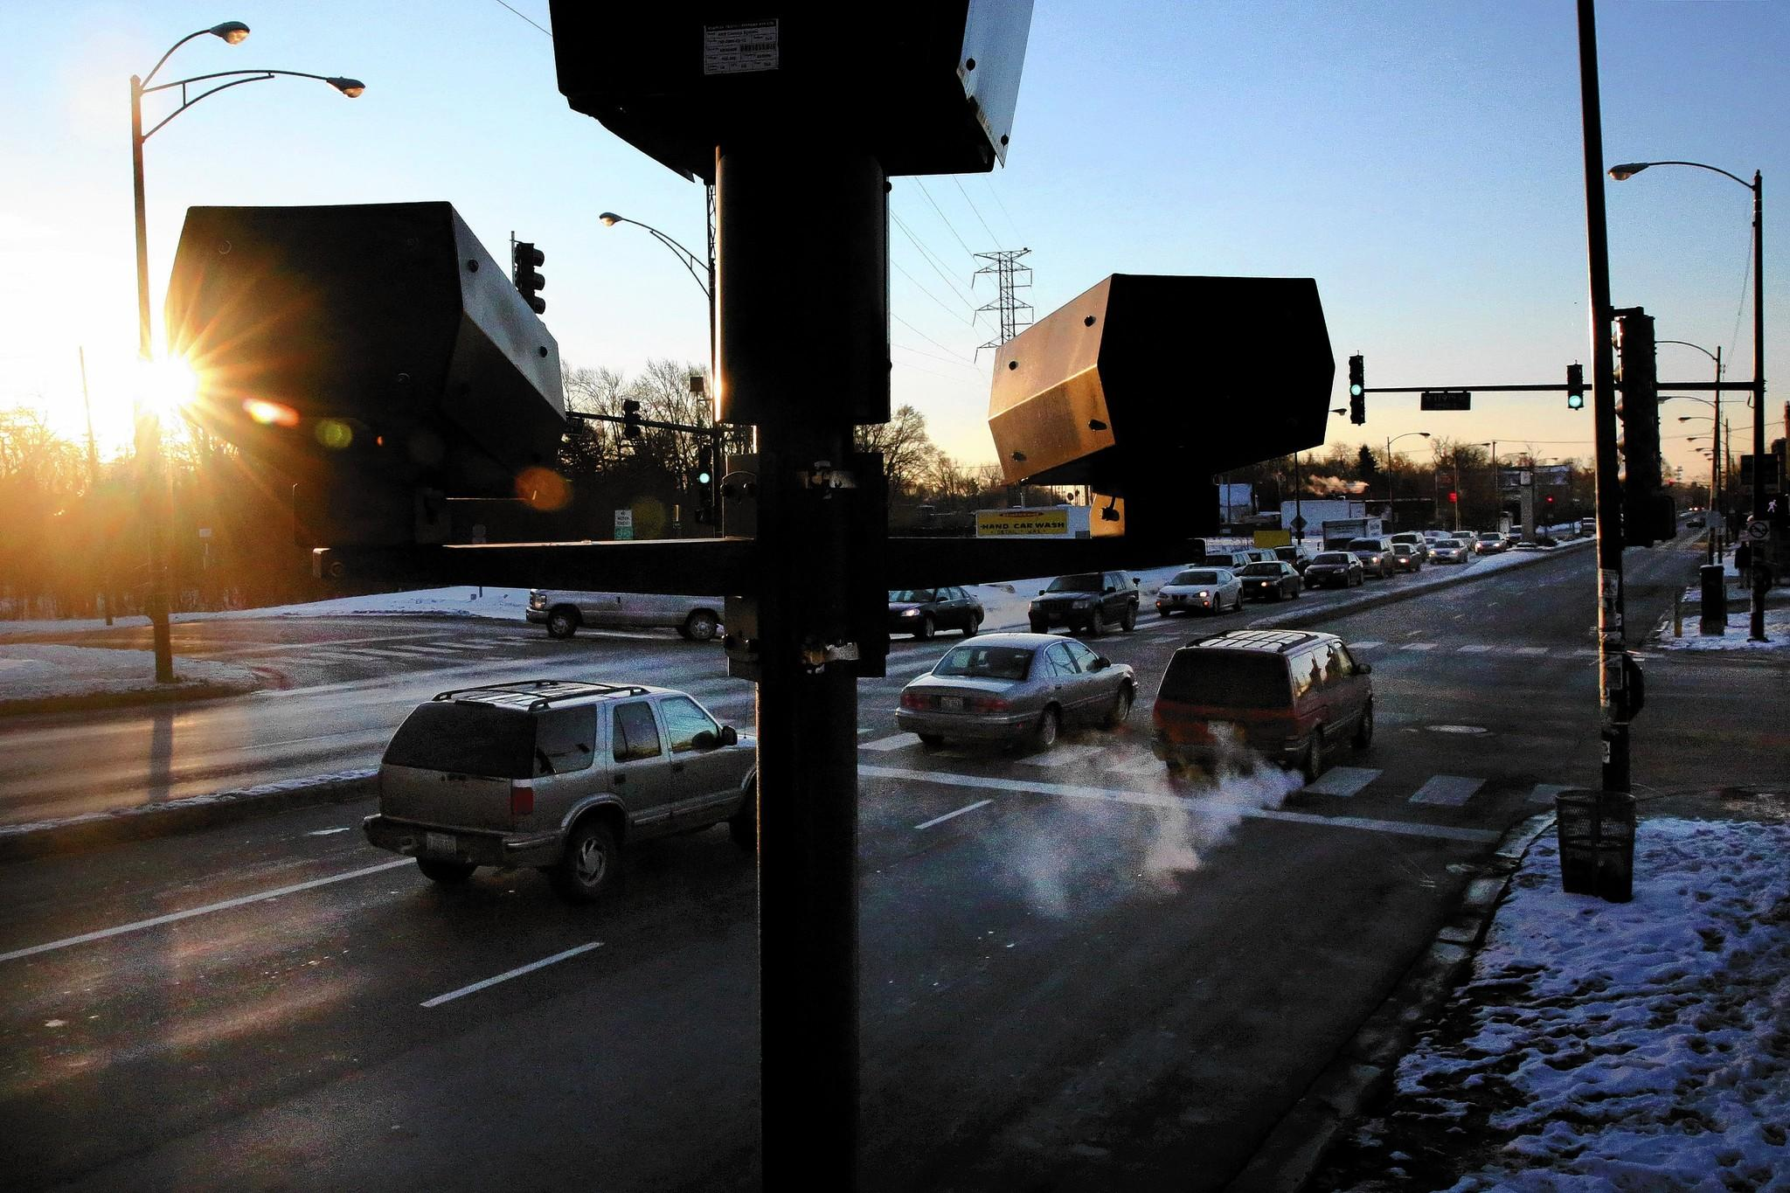
Methodology
Data Source:
NHTSA and IL State Police Crash Reporting Data
Red Light Camera Locations-Randomized
Data Mining:
IL Crash Data Set is 2 GB, 10 million rows, and 96 columns
SPSS, SAS, ArcGIS
Geospatial Determination:
Radius around intersections
How Many Feet-125ft or 135 ft
Lat (0.000655/145.357 ft) Long. (0.000655/145.279 ft)

Slide 7
Methodology
Descriptive Statistics
Total Crashes, Total Injuries, Vehicle and Behavior Characteristics at Random Red Light Camera Intersection before and after implementation of the cameras
Inferential Multivariate Model
Count Data – Distribution Type
Random Intercept Model- (Intercept a Random Variable)
Negative Binominal Distribution
Poisson distribution
Key Variables, Binary Date Variable, Total Crashes, Traffic Lanes, Injury Rates, Time
Notes:
The negative binomial distribution, also known as the Pascal distribution or Pólya distribution, gives the probability of successes and failures in trials, and success on the th trial.
is a discrete probability distribution that expresses the probability of a given number of events occurring in a fixed interval of time and/or space if these events occur with a known average rate and independently of the time since the last event.

Slide 8
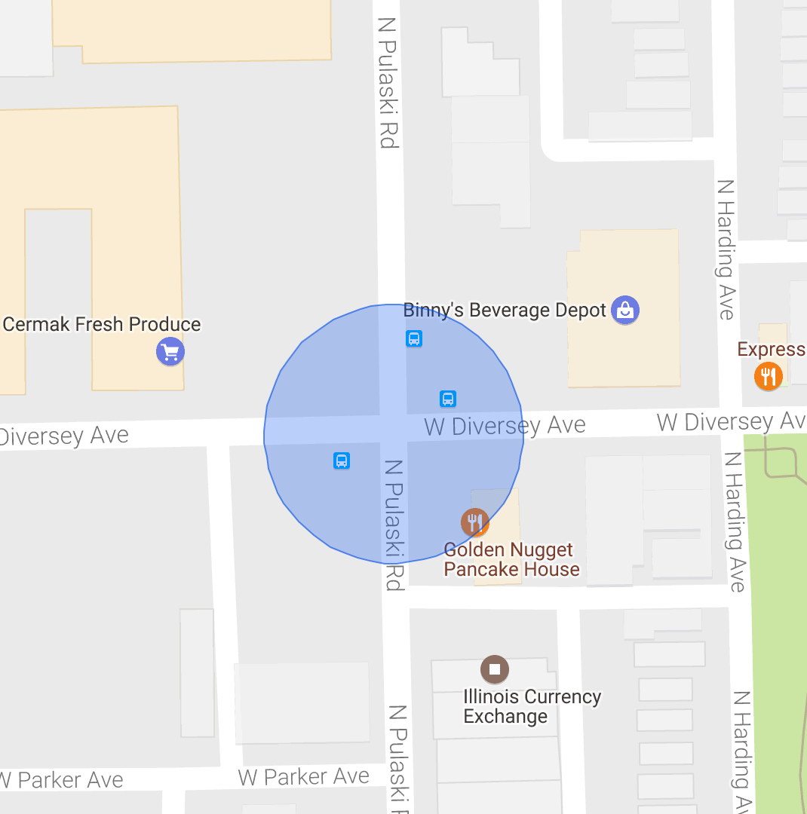
Geospatial Mapping
125 ft. Radius
135 ft. Radius
Notes:
The negative binomial distribution, also known as the Pascal distribution or Pólya distribution, gives the probability of successes and failures in trials, and success on the th trial.
is a discrete probability distribution that expresses the probability of a given number of events occurring in a fixed interval of time and/or space if these events occur with a known average rate and independently of the time since the last event.

Slide 9
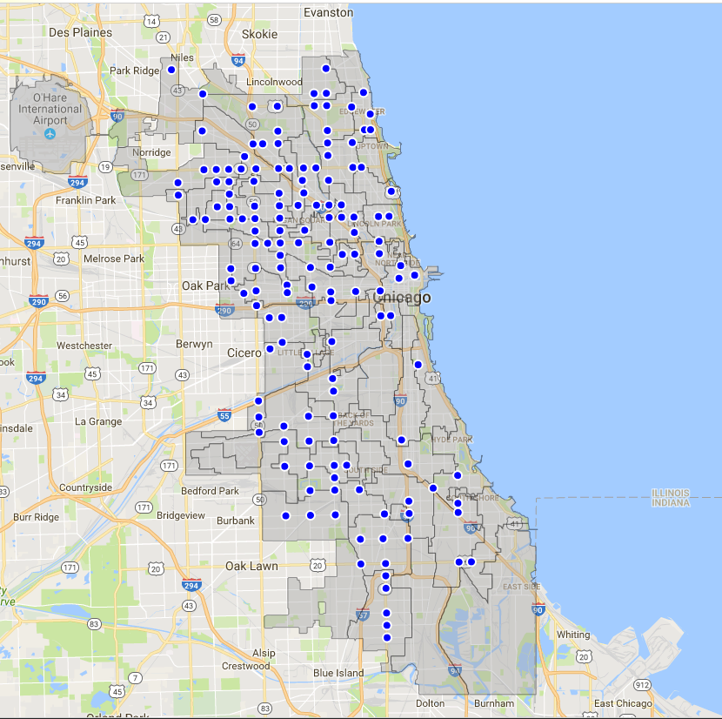
Red Light Camera Locations
151 Locations reduced from 243 location 2014
Tale of Two Cities
More Red Light Cameras on the North Side
Notes:
The negative binomial distribution, also known as the Pascal distribution or Pólya distribution, gives the probability of successes and failures in trials, and success on the th trial.
is a discrete probability distribution that expresses the probability of a given number of events occurring in a fixed interval of time and/or space if these events occur with a known average rate and independently of the time since the last event.

Slide 10
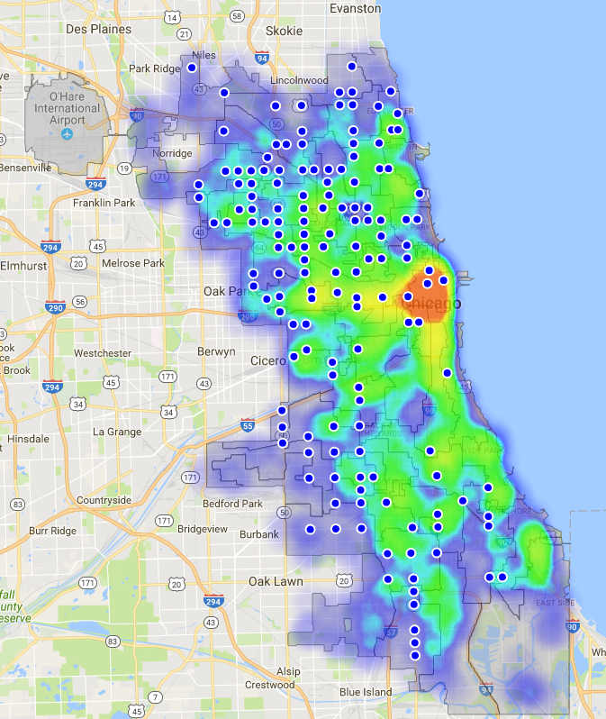
Traffic Volume and Red Light Camera Locations
Are the Camera Location Optimally Located?
Some Wards have No Cameras or just share a boarder camera
Why is so much traffic volume on the Southside have little to few cameras?
Notes:
The negative binomial distribution, also known as the Pascal distribution or Pólya distribution, gives the probability of successes and failures in trials, and success on the th trial.
is a discrete probability distribution that expresses the probability of a given number of events occurring in a fixed interval of time and/or space if these events occur with a known average rate and independently of the time since the last event.

Slide 11
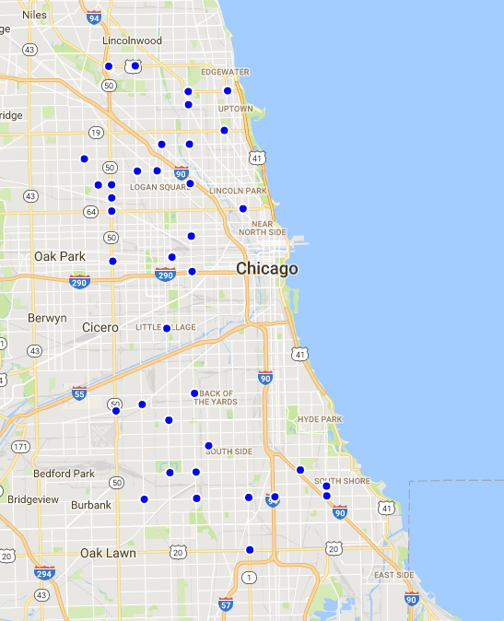
Random Red Light Camera Locations
Intersections were chosen by a randomizer in excel
40 Total Intersections – 37 Intersections
3 Intersections had no After Camera Installation Date Data
Notes:
The negative binomial distribution, also known as the Pascal distribution or Pólya distribution, gives the probability of successes and failures in trials, and success on the th trial.
is a discrete probability distribution that expresses the probability of a given number of events occurring in a fixed interval of time and/or space if these events occur with a known average rate and independently of the time since the last event.

Slide 12
Results of Study :
Table 1
 | Intersections w/Red Light Cameras Before Implementation (n= 17,378) | Percentage | Intersections w/Red Light Cameras After Implementation (n=6897) | Percentage | Difference
Number of Vehicles Involved Mean (SD) | 2.073 (0.476) |  | 2.075 (0.489)
Crash Severity
Fatal | 30 | 0.2% | 23 | 0.3% | -0.2%
Injury | 3477 | 20.0% | 1499 | 21.7% | -1.7%
Property Damage | 13871 | 79.8% | 5375 | 77.9% | 1.9%

Slide 13
Results of Study :
Table 2
 | Intersections w/Red Light Cameras (mean) Before Implementation | Percentage (N=11308) | Intersections w/Red Light Cameras (mean) After Implementation | Percentage (N=5330) | Difference
Number of Fatalities | 30 | 0.1% | 28 | 0.1% | -0.1%
Number of Injuries | 5639 | 9.6% | 2651 | 10.7% | -1.1%
Number of Disabling Injuries | 695 | 1.2% | 289 | 1.2% | 0.0%
Number of Non-disabling Injuries | 2773 | 4.7% | 1199 | 4.8% | -0.1%
Number of Possible Injuries | 2171 | 3.7% | 1163 | 4.7% | -1.0%
Number of Non-injuries | 47340 | 80.7% | 19419 | 78.5% | 2.3%
Total Persons Involved | 58648 | 100.0% | 24749 | 100.0%

Slide 14
Results of Study :
Table 3
 | Intersections w/Red Light Cameras (mean) Before Implementation (n=) | Intersections w/Red Light Cameras (mean) After Implementation (n=)
Number of Occupants - Mean (SD) | 1.94 (1.085) | 1.58 (1.036)
Age - mean (SD) | 46.146 (27.63) | 50.058 (29.64)
AgeNew-mean (SD) | 36.027(16.011) | 36.39 (15.89)
Blood Alcohol Level - Mean (sd) | 0.006 (0.046) | 0.001 (0.015)
Table 4
 | Intersections w/Red Light Cameras (mean) Before Implementation (n=) | Percentage | Intersections w/Red Light Cameras (mean) After Implementation (n=) | Percentage
Sex (Driver)
Male | 8527 | 49.1% | 3381 | 49.5%
Female | 5902 | 34.0% | 2366 | 34.6%
Unspecified | 2949 | 17.0% | 1090 | 15.9%

Slide 15
Results: Time

Slide 16
Results: Time

Slide 17
Results: Random Intercept Model
Dependent Variables: Attempted
Injury Rate per Persons
Injury Rate per Crashes
Total Crashes
Independent Variables: Attempted
Intersection Type-2 or 3
Number of Traffic Lanes
Bus Stop at Intersection
Dummy Time
Red Light Binary Intervention

Slide 18
Results: Random Intercept Model
Table 6
Summary of Negative Binominal Zero Inflated Random Intercept Model for Total Traffic Crashes at Forty Random Red Light Camera Intersections in Chicago, IL (2004-2011)
Random Intercept Model
 | Parameter | DF | Estimate | Standard Error | t Value | Pr > |t| | (95%)Lower | (95%)Upper
Intercept | b0 | 39 | 0.5842 | 0.260 | 2.25 | 0.030 | 0.059 | 1.110
Time Trend | b1 | 39 | -0.0012 | 0.001 | -1.45 | 0.154 | -0.003 | 0.000
Red Light Camera Binary Intervention* | b2 | 39 | -0.0844 | 0.040 | -2.12 | 0.041 | -0.165 | -0.004
Number of Traffic Lanes | b4 | 39 | 0.0860 | 0.034 | 2.56 | 0.015 | 0.018 | 0.154
Zero-Inflated Random Intercept Model
Zero Inflated Intercept | a0 | 39 | 0.5911 | 0.156 | 3.78 | 0.001 | 0.275 | 0.907
Zero Inflated Time Trend | a1 | 39 | -0.2125 | 0.018 | -11.75 | <.0001 | -0.249 | -0.176
Zero Inflated Red Light Camera Intervention^ | a2 | 39 | 0.8989 | 0.522 | 1.72 | 0.093 | -0.157 | 1.954
Negative Binominal Distribution and Model Choice
Random Intercept model* | sigma2 | 39 | 0.1882 | 0.045 | 4.21 | 0.000 | 0.098 | 0.279
Negative Binomial Distribution* | alpha | 39 | 0.0521 | 0.009 | 5.56 | <.0001 | 0.033 | 0.071

Slide 19
Summary of Results
Chicago’s Red-light Cameras Work at reducing Total Crashes at Red-light Camera Intersection (8.4% Reduction)
Men are more likely to be the Driver
Fridays / Saturdays and Midnight have natural High Crash Rates
Descriptively, Fatalities and Injuries are down from (2004-2011) at those traffic intersections
Findings Support-IDOT, Northwestern, Chicago State

Slide 20
Limitations
Missing Data Entries, large number of zeros
Radius Geospatial Size
No Control Group for Spill Over Effect
No Control for Crashes at Non-Red Light Camera Intersectons

Slide 21
References
Retting, Richard A., Susan A. Ferguson, and Charles M. Farmer. “Reducing Red Light Running through Longer Yellow Signal Timing and Red Light Camera Enforcement: Results of a Field Investigation.” Accident Analysis & Prevention 40, no. 1 (January 2008): 327–33.
Mahmassani, H. S., Schofer, J. L., Johnson, B. L., Verbas, O., Elfar, A., Mittal, A., & Ostojic, M. (2017). Chicago Red Light Camera Enforcement. Northwestern Transportation Center
Kull, R. S. (2014). The effect of red light cameras on intersection-related automobile crashes in chicago, illinois (Order No. 1591496). Available from ProQuest Dissertations & Theses Global. (1697862108).
Aeron-Thomas, Amy, and Stephane Hess. “Red-Light Cameras for the Prevention of Road Traffic Crashes.” In Cochrane Database of Systematic Reviews. John Wiley & Sons, Ltd, 2005.
City of Chicago Data Portal (2017): Red Light Camera Locations, https://data.cityofchicago.org

