Slide 1
Does the Prevalence of Inadequate Access to Healthcare Services Differ by Industry? (Illinois BRFSS, 2018-2020)
Authors: Meghan Cerpa MPH, Samantha Saini MPH, Linda Forst MD MPH

Slide 2
Background
Average full-time U.S. worker spends half their waking life at work (DHHS, 2022)
Work is a determinant of health in many ways:
Hazardous exposure and risk
Source of income and social benefits
Driver of social position and status
Disparities in employment
Educational attainment
Gender and gender identity
Race and Ethnicity
COVID-19 highlighted importance of work and well-being (DHHS, 2022)
Exacerbated already existing disparities
Notes:
BLS: Individuals who were employed in service occupations remained more likely to be among the working poor than those employed in other major occupational groups.
DHHS: People with steady employment are less likely to live in poverty and more likely to be healthy, but many people have trouble finding and keeping a job. In addition, many people with steady work still don’t earn enough to afford the things they need to stay healthy.
Individuals with less education have fewer employment choices, which may force them into positions with low levels of control, job insecurity, and low wages.⁹ Individuals with less education are also more likely to have jobs that are physically demanding or include exposure to toxins (Berkman).
Women more likely experience sexual harassment in workplace
Certain industries and occupations employ higher proportions of Hispanic/Latinx workers, such as agriculture
COVID PART: Frontline/essential workers experienced COVID-19 outbreaks by nature of their occupations. Those who were required to leave home for work were exposed to hospitalized patients, congregate/nursing home residents, individuals in correctional custody, co-workers, and the public. Some of the hardest hit sectors preferentially employ women, immigrants, people of color, and low-wage workers. Ex, agricultural work, food manufacture and packaging, and transportation and warehousing preferentially employ Latinx immigrants, home care and day care employ women, immigrants, and African Americans, and public transit employs a high proportion of African Americans.

Slide 3
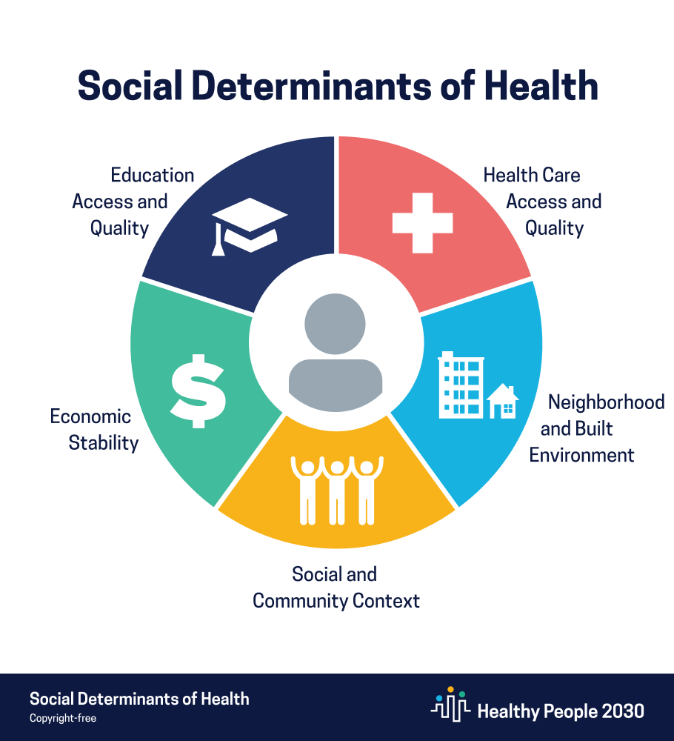
Background
Social Determinants of Health (SDoH) influence health disparities and health inequities (DHHS, 2022)
Economic stability
Employment
Food & housing insecurity
Poverty
Notes:
DHHS: “Social determinants of health (SDOH) are the conditions in the environments where people are born, live, learn, work, play, worship, and age that affect a wide range of health outcomes and risks.”
Research suggests SDoH account for between 30-55% of health outcomes (WHO)
past two decades there has been a significant shift from traditional work arrangements (direct hire by a single employer, decent wages, social benefits) to precarious work (contract work, gig work, temporary staffing, informal/cash work, under-employment, low wages, no social benefits) (Weill, 2014).
So by adding to health disparity literature/evidence leveraging data & surveillance and subsequent evaluation and evidence building we can target workers in certain industries with higher prevalence of inadequate access to healthcare
Goal: Help people earn steady incomes that allow them to meet their health needs

Slide 4
Background
Illinois is 6th largest state
Diverse population representative of overall U.S. population (Kolko, 2016; USCB, 2021)
Robust employment across multiple high-risk industries (BLS, 2021)
Transportation & Warehousing, Utilities, Manufacturing, and Construction
Over 20% of the workforce is employed in high-risk occupations
11.3% employed in high morbidity occupations and high mortality industries (NIOSH)
Notes:
high-risk occupations defined as those private sector occupations in the U.S. that have a two-fold or higher rate of injuries or illnesses involving one or more missed days of work
*REMOVED AGRICULTURE AND MINING BC NOT ABLE TO GET ESTIMATES FOR THESE INDUSTRIES
Kemba’s presentation – from 2010 to 2020 IL Hispanic population grew by 15.3%

Slide 5
Objective
Estimate the prevalence of inadequate healthcare access indicators in the Illinois workforce by industry using the Behavioral Risk Factor Surveillance System
Notes:
Understanding the gaps in health outcomes and risk behaviors between the differing industries and occupations will help develop targeted public health interventions and ultimately improve population health

Slide 6
Learning Objectives
Examine work as a determinant of access to healthcare in the BRFSS
Understand the utility and value of including the Industry and Occupation Optional BRFSS Module

Slide 7
Methods – Survey Design
Cross-sectional, national, random-digit-dialing health survey
Designed to collect information on health behaviors and health outcomes from a representative sample of the U.S. (CDC, 2023)
15 core standardized sections
Illinois Department of Public Health administers multiple optional modules
Sexual orientation and gender identity
Marijuana use
E-cigarette use
Optional Industry/Occupation (I/O) module asks respondents their industry and occupation
Illinois has included I/O module since 2015

Slide 8
Methods – Industry Categorization
All BRFSS respondents asked about their employment status
Those who answered they were “currently employed for wages, self-employed, or out of work for less than one year” were later asked their:
Industry: “what kind of business or industry do you work in?”
Occupation: “what kind of work do you do?”
Answers assigned Census Industry Codes (CIC)
National Institute for Occupational Safety and Health (NIOSH) Industry and Occupation Computerized Coding System (NIOCCS)
Responses NIOCCS is unable to code were then coded manually if possible
Two-digit National Health Interview Survey (NHIS) codes
Broader groupings of CIC
20 industry groups were used for final analysis categorization
Notes:
Final SS 6960

Slide 9
Methods – Statistical Analysis
SAS v9.4 using PROC SURVEYFREQ
Accommodate survey sampling methods
Final survey weights are provided by the CDC for each survey year
Adjusted to correct for multiple cycles (2018-2020)
Prevalence estimates and 95% confidence intervals provided for all workers employed/out of work <1-year with a valid industry code
Prevalence estimates were suppressed for sub-groups:
Sample size: n<50
High variance: Coefficient of Variation>0.30
Significance (p<0.05) determined by Rao-Scott chi-square tests comparing industry sub-groups to all workers
Notes:
Survey weighting is used to reduce bias and create a representative state sample.
COV used to determine the validity of the prevalence estimates,

Slide 10
Distribution of Illinois Workforce in the US Census American Community Survey (ACS) & BRFSS, 2018-2020
Industry Group | ACS (%) | BRFSS (%)
Agriculture, Forestry, Fishing & Hunting | 0.9 | 1.5
Mining, Quarrying, & Oil & Gas Extraction* | 0.2 | 0.3
Construction | 5.4 | 8.0
Manufacturing | 11.7 | 12.1
Wholesale Trade | 2.9 | 1.4
Retail Trade | 10.5 | 8.8
Transportation & Warehousing | 6.0 | 5.8
Utilities | 0.7 | 0.8
Information | 1.8 | 1.7
Finance & Insurance | 5.6 | 5.1
Real Estate & Rental & Leasing | 1.7 | 1.7
Professional, Scientific, & Technical Services | 7.8 | 7.6
Management of Companies & Enterprises* | 0.2 | 0.5
Administrative, Support, & Waste Services | 4.1 | 4.1
Educational Services | 9.4 | 8.6
Health Care & Social Assistance | 13.9 | 15.4
Arts, Entertainment, & Recreation | 2.0 | 1.6
Accommodation & Food Services | 6.7 | 5.9
Other Services | 4.7 | 4.9
Public Administration | 3.7 | 4.0
* = n<50
Notes:
To assess whether the BRFSS survey respondents were representative of the employed adult population in Illinois we compared estimates from the American Community Survey (ACS) conducted by the U.S. Census Bureau (USCB) in Table 2 (USCB, 2023). Overall, the estimates were similar between ACS and BRFSS (none varying by more than 2%). BRFSS does not provide a representative sample of persons in the military, thus estimates for this industry group are not provided. Mining and mgmt. had SS less than 50 thus we were not able to provide stable estimates for these industries

Slide 11
Results: Percentage of IL Workers Without HealthCare Coverage by Industry
All respondents were asked if they had any type of healthcare coverage including:
Health insurance
Prepaid plans such as HMOs
Government plans such as Medicare, or Indian Health Service
= No Difference = Significantly Higher = Significantly Lower
Notes:
Compared to all workers, the prevalence of not having health care coverage was significantly:
Higher:
Accommodation & Food Services
Administrative, Support, & Waste Services
Transportation & Warehousing
Manufacturing
Other Service Industries
Construction
Lower:
Healthcare & Social Assistance
Professional, Scientific, & Technical Services
Education
All workers = respondents with an industry code
Results not shown for the following groups due to high variance (CV>0.3): Agriculture, Forestry, Fishing, & Hunting; Utilities; Wholesale Trade; Information; Finance & Insurance; Arts, Entertainment, & Recreation; Public Administration
Results not shown for the following groups due to insufficient sample size (n<50): Mining, Quarrying, Oil, & Gas; Management of Companies & Enterprises; Military

Slide 12
Results: Percentage of IL Workers Without a Personal Physician by Industry
All respondents were asked if they have one person they think of as their personal doctor or healthcare provider
= No Difference = Significantly Higher = Significantly Lower
Notes:
Compared to all workers, the prevalence of not having a personal physician was significantly:
Higher:
Accommodation & Food Services
Manufacturing
Transportation & Warehousing
Construction
Lower:
Finance & Insurance
Healthcare & Social Assistance
Public Administration
Education
All workers = respondents with an industry code
Results not shown for the following groups due to high variance (CV>0.3): Agriculture, Forestry, Fishing, & Hunting; Utilities

Slide 13
Results: Percentage of IL Workers Reporting They Could Not See a Doctor Due to Cost in The Past Year by Industry
All respondents were asked whether there was any time in the past year when they were unable to see a doctor due to cost
= No Difference = Significantly Higher = Significantly Lower
Notes:
Compared to all workers, the prevalence of not being able to see a physician in the past year due to cost was significantly:
Higher:
Accommodation & Food Services
Lower:
Finance & Insurance
Professional, Scientific, & Technical Services
Education
Public Administration
Results not shown for the following groups due to high variance (CV>0.3): Agriculture, Forestry, Fishing, & Hunting; Utilities; Information

Slide 14
Discussion - Accommodation & Food Services (AFS)
Highest prevalence of healthcare access barriers
Highest prevalence of not being able to see a doctor due to cost (20.6%) and workers without healthcare coverage (28.7%)
2nd highest prevalence of not having primary care physician (30.1%)
AFS also had significantly higher prevalence of:
Depression diagnoses
Current smokers
Engaging in risky HIV behavior
Fair/poor overall health
Poor physical & mental health days
Workers identifying as LGBTQIA+
Notes:
Why findings are important / implications
We assessed other BRFSS core sections and found AFS had sig higher prevalence of….
Underscoring the importance of the healthcare access findings

Slide 15
Discussion - Accommodation & Food Services (AFS)
Low job security industry
Often short-term, high turnover
No remote work option
Requires travel and transportation
Individuals who were employed in service industries and occupations remained more likely to be among the working poor (BLS, 2022)
Lowest paid industry in 2022 (BLS, 2022)
62.4% at or below minimum wage
44.7% below minimum wage
Hispanic/Latinx women more likely to be employed in AFS (BLS, 2022)
Notes:
Why findings are important / implications
Hispanic women were more likely to work in leisure and hospitality (13 percent) than were White women (10 percent), Asian women (9 percent), and Black women (8 percent) (BLS, 2022)

Slide 16
Discussion – Construction
High prevalence of barriers to healthcare access
3rd highest prevalence of workers without healthcare coverage (20.9%)
Highest prevalence of not having primary care physician (32.3%)
Construction also had significantly higher prevalence of:
Heavy and/or binge drinking
Current smokers
Overweight or obese
High rates of injury and illness cases
3.0 per 100 full-time workers in 2018
3.2 per 100 full-time workers in 2022
Hispanics/Latinx more likely to work in the construction industry (BLS, 2022)
Notes:
From report:
The Construction and Manufacturing industries lacked adequate access to healthcare, both having a higher prevalence of not having healthcare coverage nor a personal care physician. Those in the Construction industry reported not attending routine dental and doctor visits although they had a lower prevalence of cancer, depression, and diabetes. Risky health behaviors such as smoking, heavy and/or binge drinking, and not always wearing a seatbelt were more commonly seen in Construction, while both Construction and Manufacturing had a higher prevalence of being overweight or obese.

Slide 17
Discussion – Healthcare & Social Assistance (HSS)
Adequate access to healthcare
Significantly lower prevalence of not having a primary care physician and no healthcare coverage
Pre-COVID frontline/essential healthcare workers had significantly higher prevalence of:
Poor mental health days
Depression
Diabetes
Arthritis
Large proportions of female workers across all races and ethnicities
Notes:
A large share of employed women across all race and ethnicity groups worked in education and health services: Blacks (40 percent), Whites (35 percent), Asians (32 percent), and Hispanics (29 percent).

Slide 18
Discussion – Additional Industries of Concern
Significantly higher prevalence of not having a primary care physician and no healthcare coverage:
Manufacturing
Transportation and Warehousing
Higher incidence rates of injury in these industries
High proportions of vulnerable populations employed
Black/African Americans more likely to work in Transportation and Warehousing

Slide 19
Strengths & Limitations
Strengths
Generalizability
Help develop targeted public health/policy interventions
Limitations
Cross-sectional
High variances
Non-response
Univariate/no confounding control

Slide 20
Future Work
Assess health disparities by occupation
Multivariable Regression analysis
Could Industry/Occupation be an indicator for social determinants of health challenges?
Assess alternative raking procedures
Add 2021 I/O data

Slide 21
Conclusions
Economic instability and lack of healthcare coverage were barriers to healthcare access for AFS workers
Lack of health insurance was a barrier to healthcare access for multiple other industries
The Industry and Occupation module of BRFSS can guide approaches to achieving health equity for vulnerable populations

Slide 22
THANK YOU!
Contact Information:
Email: mcerpa2@uic.edu
Additional findings available in full report
- IL Department of Public Health will release the report in upcoming months

Slide 23
References
Berkman, L. F., Kawachi, I., & Theorell, T. (2014). Working conditions and health. In Social Epidemiology (pp. 153–181). Open University Press.
Bureau of Labor Statistics. Illinois Economy at a Glance, July 2021. https://www.bls.gov/eag/eag.il.htm.
Bureau of Labor Statistics. A profile for the working poor, 2019. Report 1093, May 2021. https://www.bls.gov/opub/reports/working-poor/2019/home.htm#BLStable_2021_4_21_14_25_footnotes
Centers for Disease Control (CDC). 2023. Behavioral Risk Factor Surveillance System. https://www.cdc.gov/brfss/index.html
Dept. of Health and Human Services. Employment - Healthy People 2030 | health.gov. (2022). Retrieved April 6, 2024, from https://health.gov/healthypeople/priority-areas/social-determinants-health/literature- summaries/employment
Kolko, J., 2016. ‘Normal America’ Is Not A Small Town Of White People. ABC News, Five-Thirty Eight. https://fivethirtyeight.com/features/normal-america-is-not-a-small-town-of-white-people/.
US Census Bureau. Illinois Quick Facts. 2020. https://www.census.gov/quickfacts/IL.
US Census Bureau. Statistical Abstract of the United States: 2012. https://www.census.gov/library/publications/2011/compendia/statab/131ed.html. Last accessed June 23, 2020a.
US Census Bureau. American Community Survey, Ranking Tables. https://www.census.gov/acs/www/data/data-tables- and- tools/ranking-tables/. Last accessed May 30, 2023.

